Slide 2
And the rhythm of life is a powerful beat,
Puts a tingle in your fingers and a tingle in your feet,
Rhythm in your bedroom, rhythm in the street,
Yes, the rhythm of life is a powerful beat.

Slide 3
A rhythm of life is a personal framework of “rhythms” which are practices, relationships, and patterns that help shape our life journey around the way of Jesus.

Slide 4
Means of Grace
By Jim Curtis

Slide 5
1) Means of Grace are sacred moments where Christ becomes present anew.
Means of Grace are rhythms God uses to share His grace with us.

Slide 6
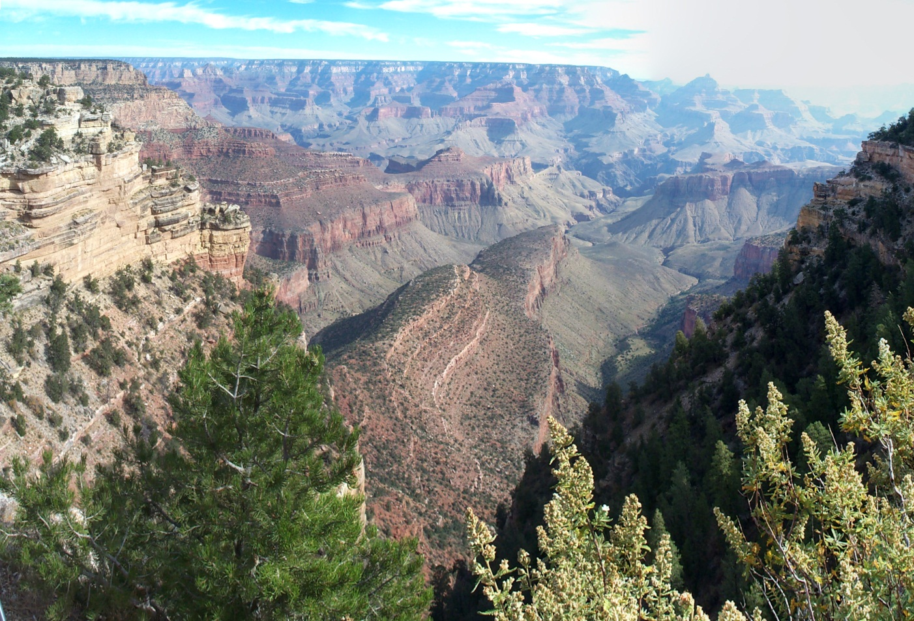
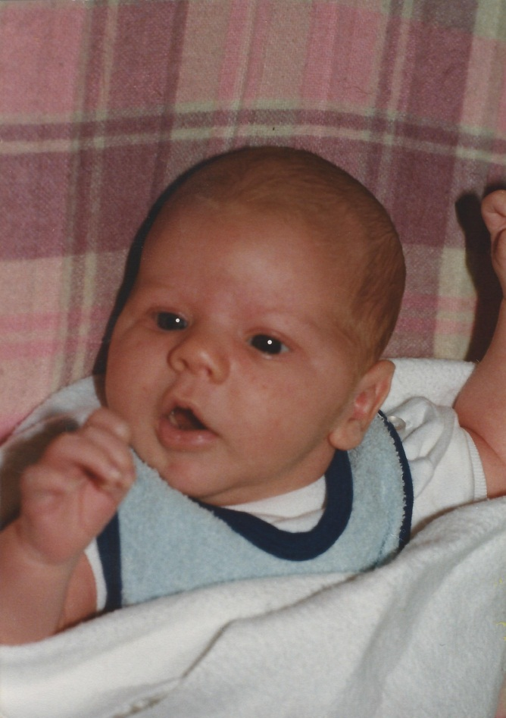
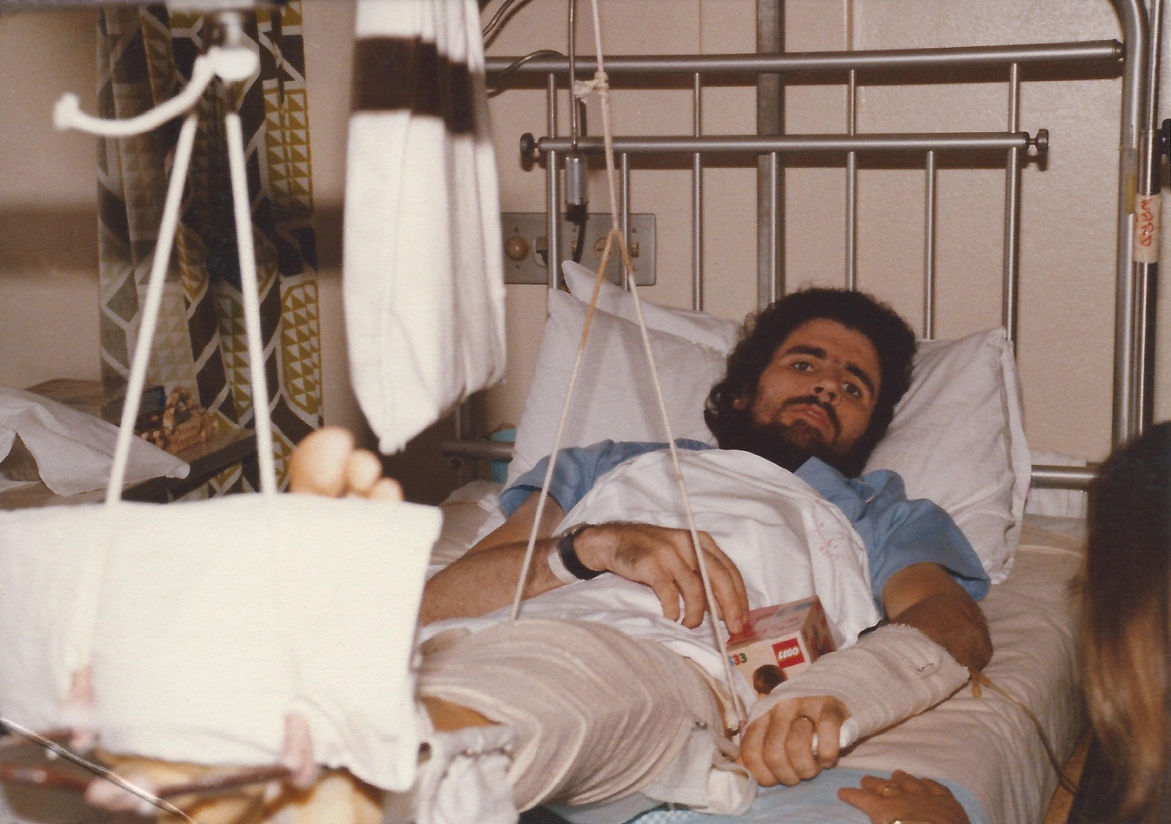
2) Sacred moments are special moments with God.
Some sacred moments come as a surprise.

Slide 7
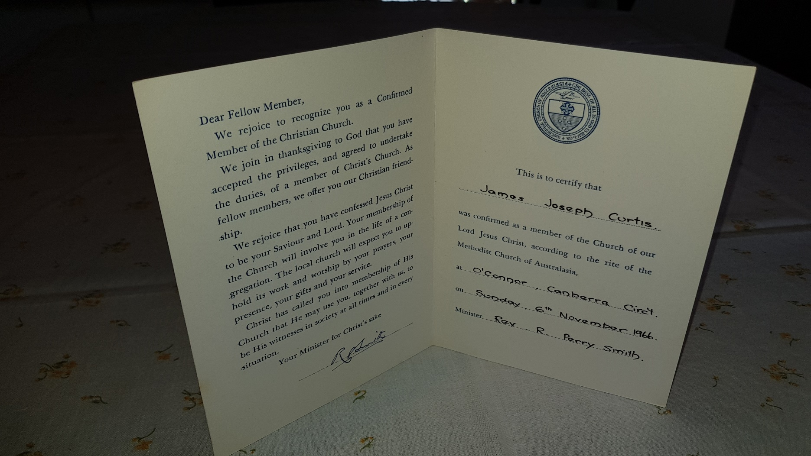
2) Sacred moments are special moments with God.
Confirmation.
Marks a new level of responsibility that one takes for one’s own faith.

Slide 8
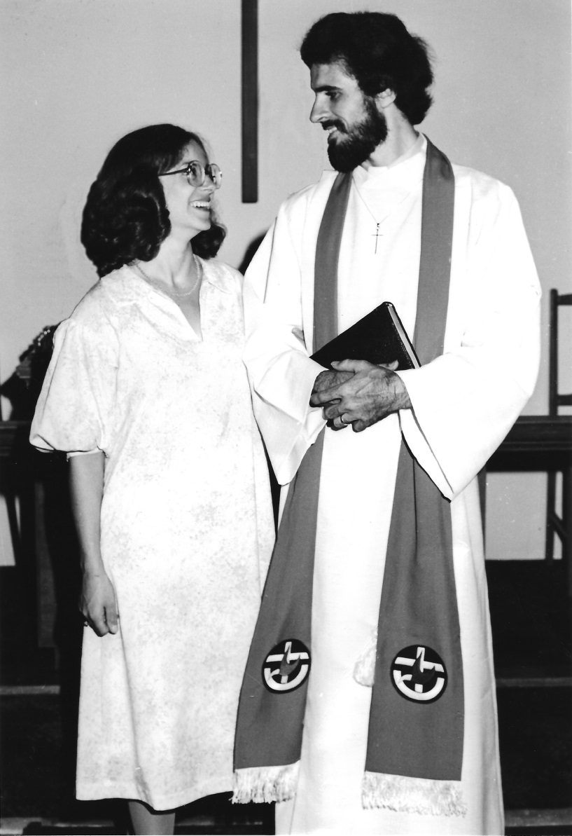
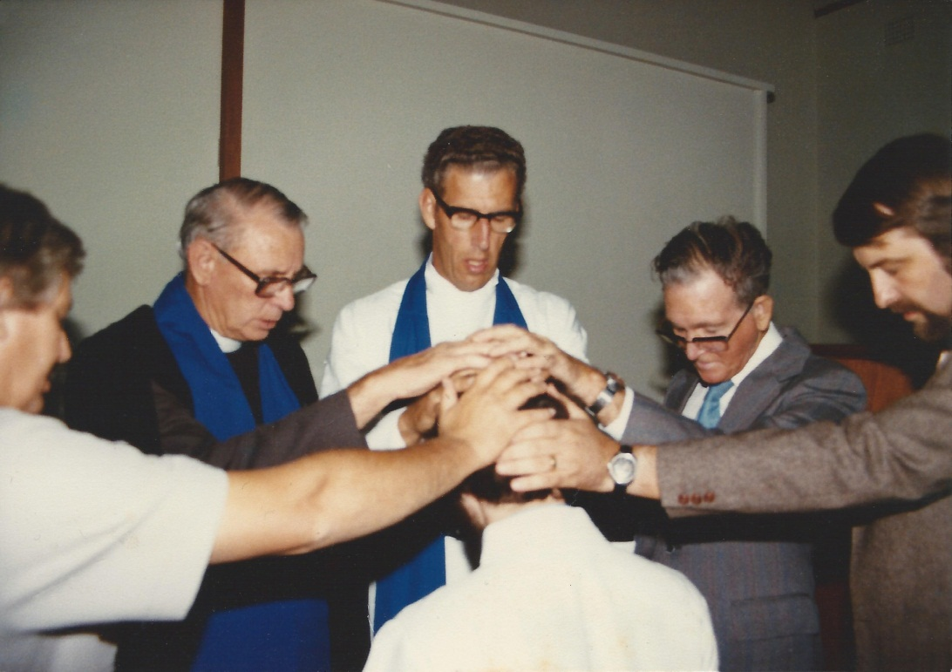
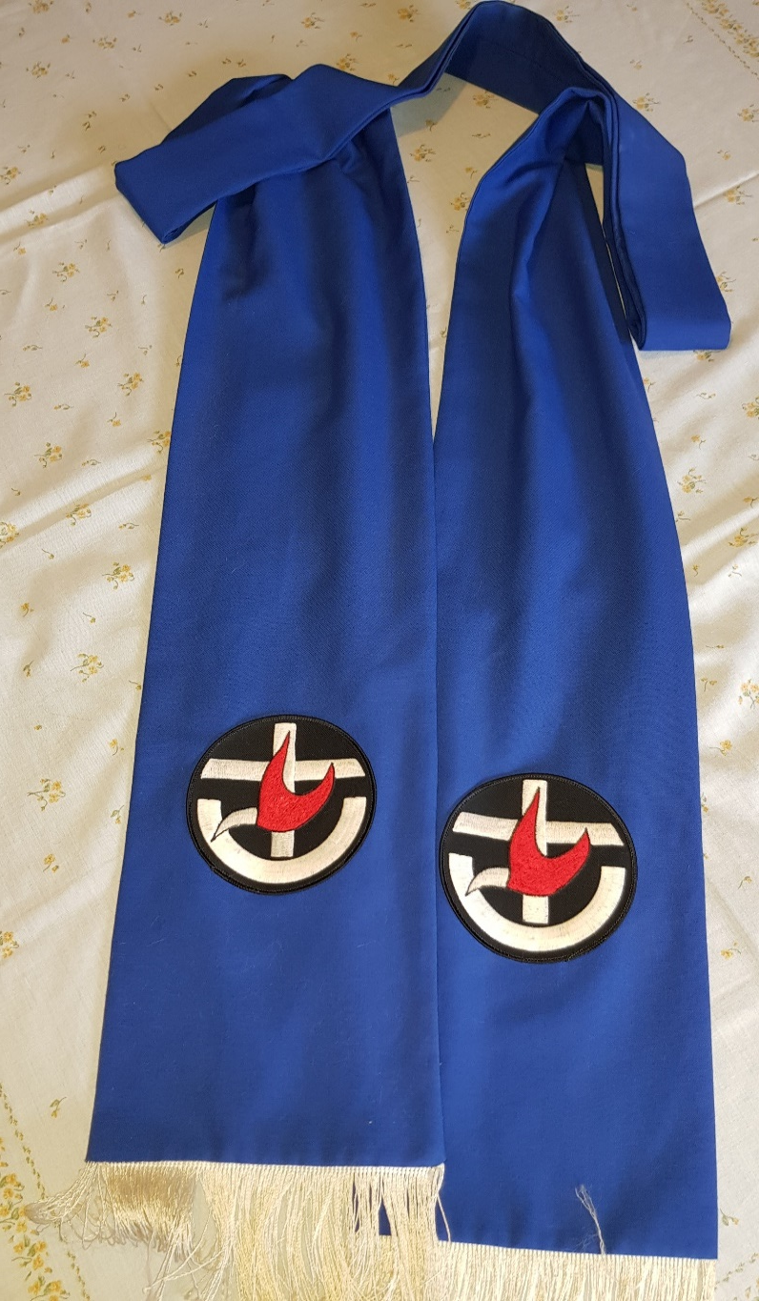
2) Sacred moments are special moments with God.
Ordination.
A congregation marks the transition of those called to pastoral leadership within the body of Christ.

Slide 9
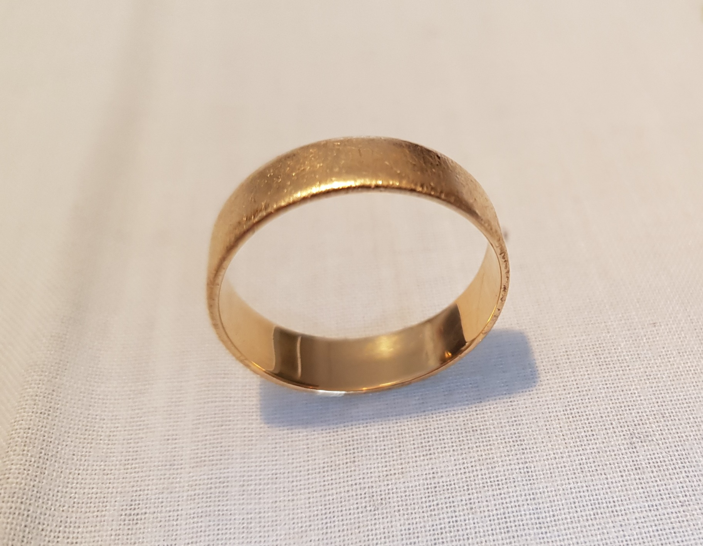
2) Sacred moments are special moments with God.
Marriage and Singleness
The grace of God empowers us all to live a loving, productive and abundantly fulfilling life in singleness first of all, and for many, in marriage as well.
1 Cor 7:32-35
The Holy Spirit frees singles to devote more time and energy to serving Christ and His Church in ministry.

Slide 10
2) Sacred moments are special moments with God.
Marriage and Singleness
In marriage the responsibility is to give yourself in representing Christ to your mate, your family and your community.
Col 3:12 Therefore, as God’s chosen people, holy and dearly loved, clothe yourselves with compassion, kindness, humility, gentleness and patience. 13 Bear with each other and forgive one another if any of you has a grievance against someone. Forgive as the Lord forgave you. 14 And over all these virtues put on love, which binds them all together in perfect unity.

Slide 11
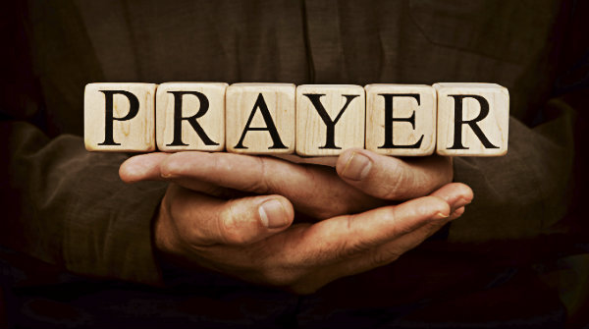
3) Sacred moments are divine appointments with God.
There are rhythms that we can do daily as individuals that will help us connect to God.

Slide 12
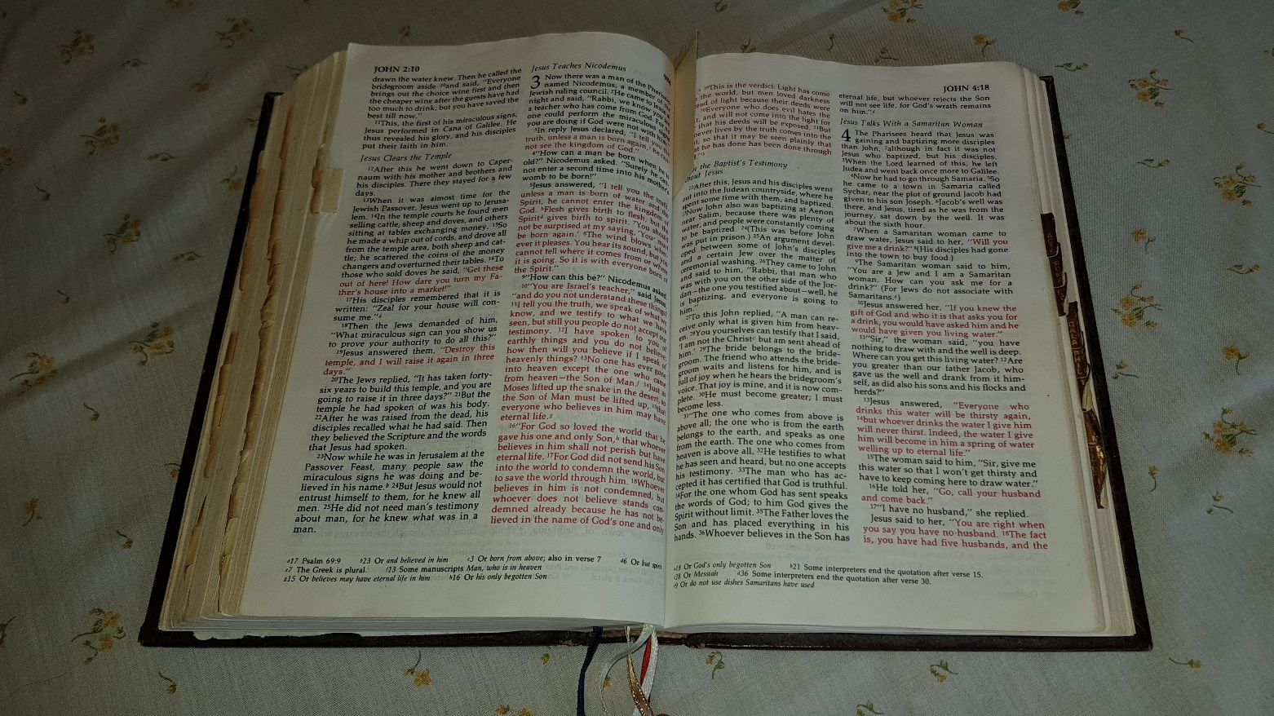
3) Sacred moments are divine appointments with God.
There are rhythms that we can do daily as individuals that will help us connect to God.
Prayer.
Reading the Bible

Slide 13
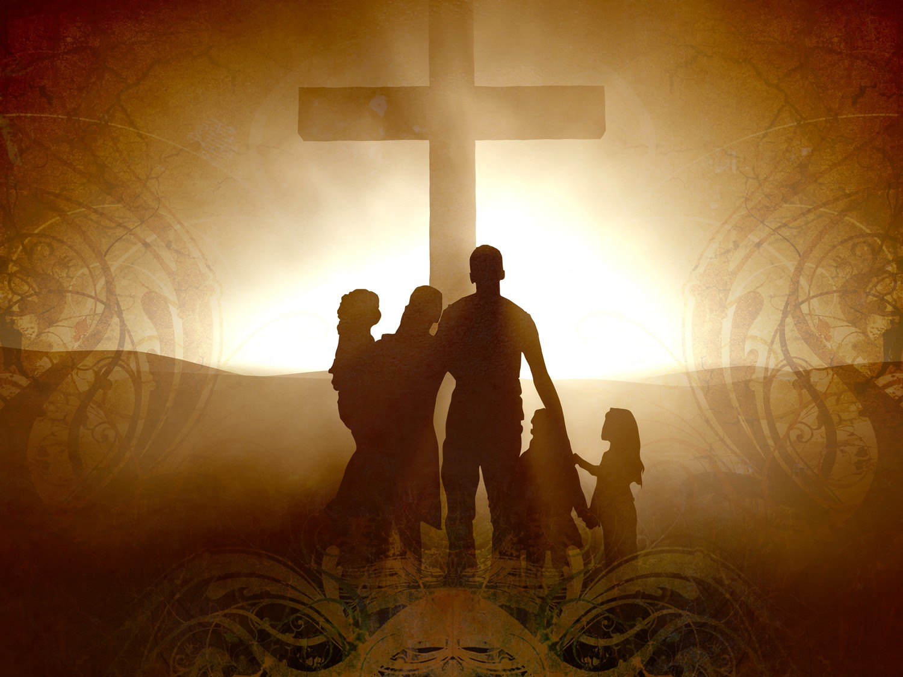
3) Sacred moments are divine appointments with God.
There are rhythms that we can do daily as individuals that will help us connect to God.
Prayer.
Reading the Bible
Worship

Slide 14
3) Sacred moments are divine appointments with God.
There are rhythms that we can do daily as individuals that will help us connect to God.
Prayer.
Reading the Bible
Small Group
Worship

Slide 15
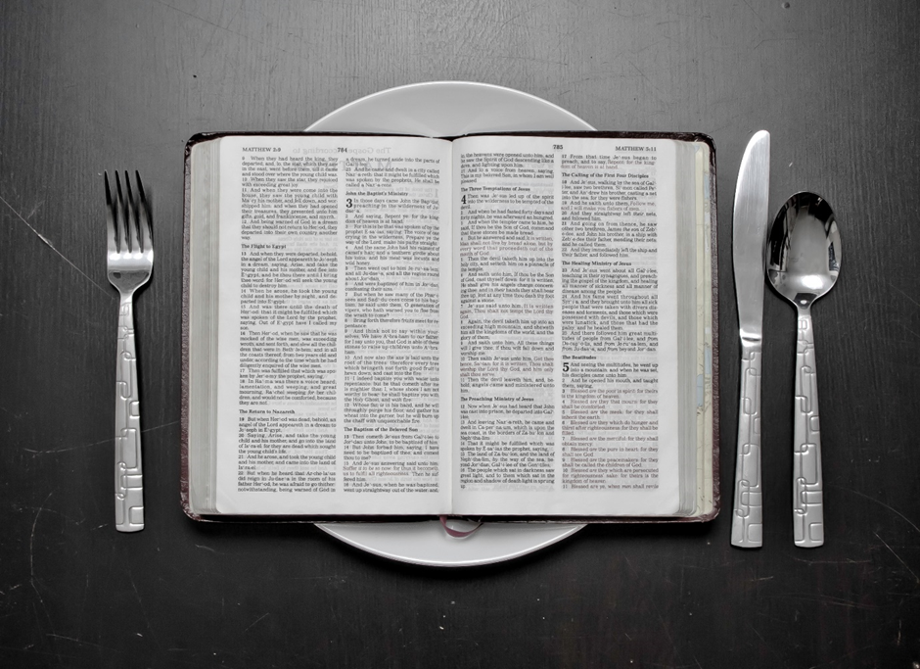
3) Sacred moments are divine appointments with God.
There are rhythms that we can do daily as individuals that will help us connect to God.
Prayer.
Reading the Bible
Small Group
Fasting
Worship

Slide 16
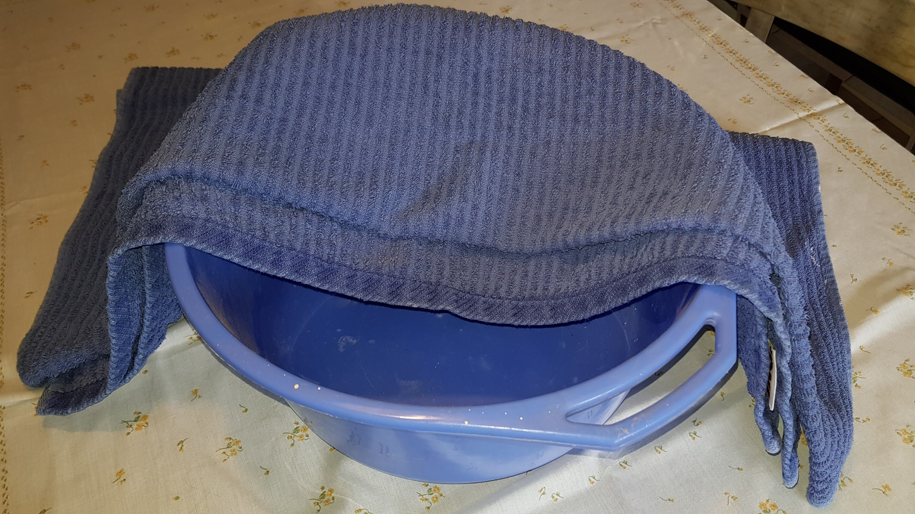
3) Sacred moments are divine appointments with God.
There are rhythms that we can do daily as individuals that will help us connect to God.
Prayer.
Reading the Bible
Small Group
Fasting
Worship
Generosity

Slide 17
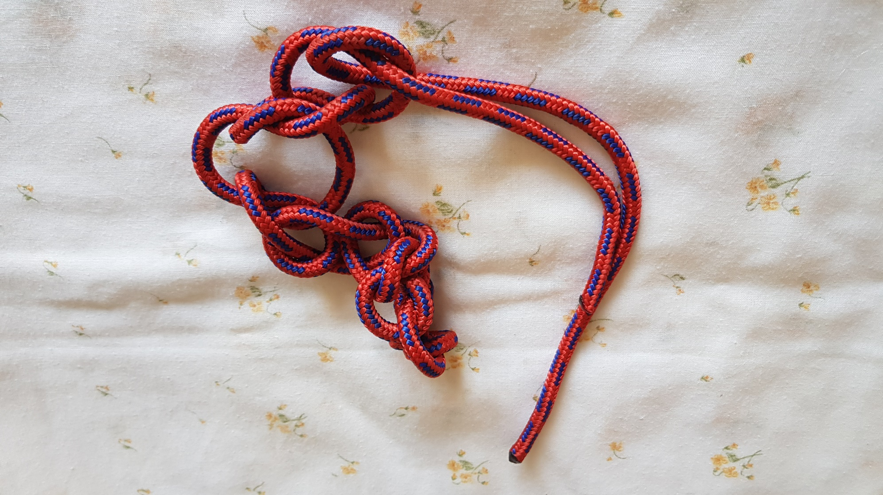
4) Sacred moments also occur in the shared experiences of confession, forgiveness, healing and reconciliation.
Confession.
James 5:16, 1 John 1:9

Slide 18
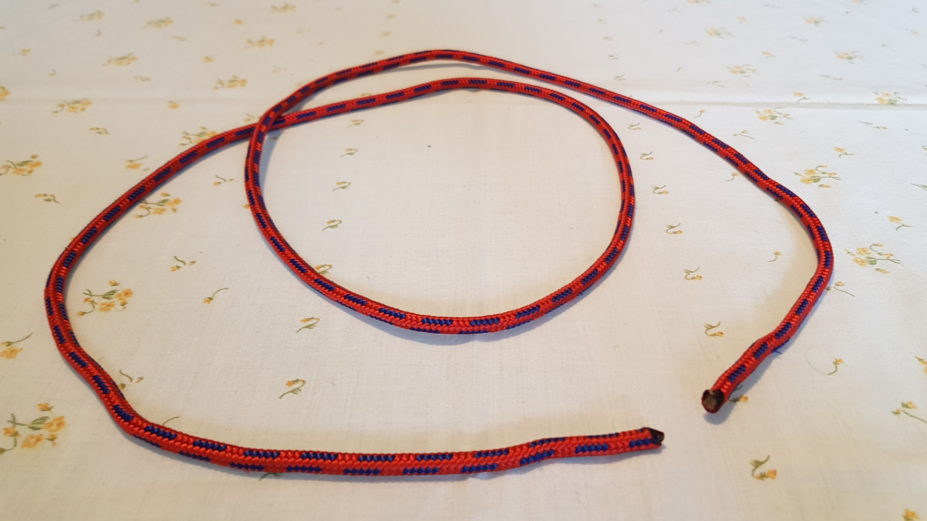
4) Sacred moments also occur in the shared experiences of confession, forgiveness, healing and reconciliation.
Confession.
James 5:16, 1 John 1:9
Forgiveness

Slide 19
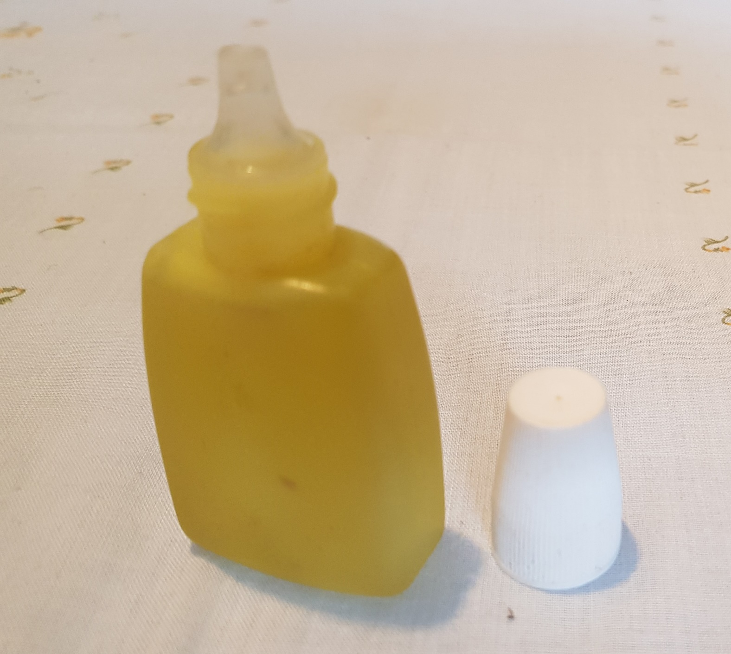
4) Sacred moments also occur in the shared experiences of confession, forgiveness, healing and reconciliation.
Confession.
James 5:16, 1 John 1:9
Forgiveness
Healing

Slide 20
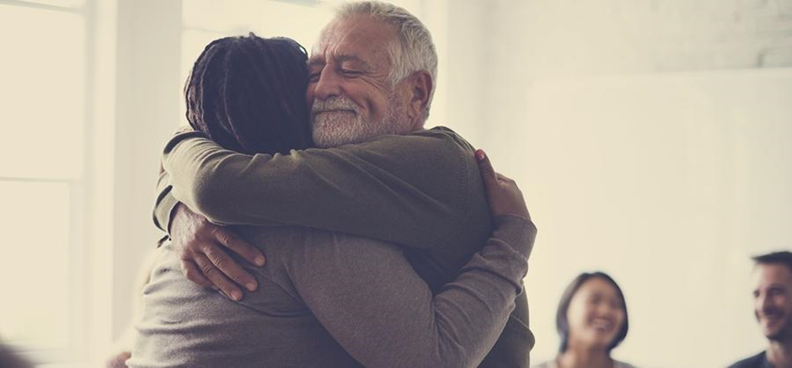
4) Sacred moments also occur in the shared experiences of confession, forgiveness, healing and reconciliation.
Confession.
James 5:16, 1 John 1:9
Forgiveness
Healing
Reconciliation

Slide 21
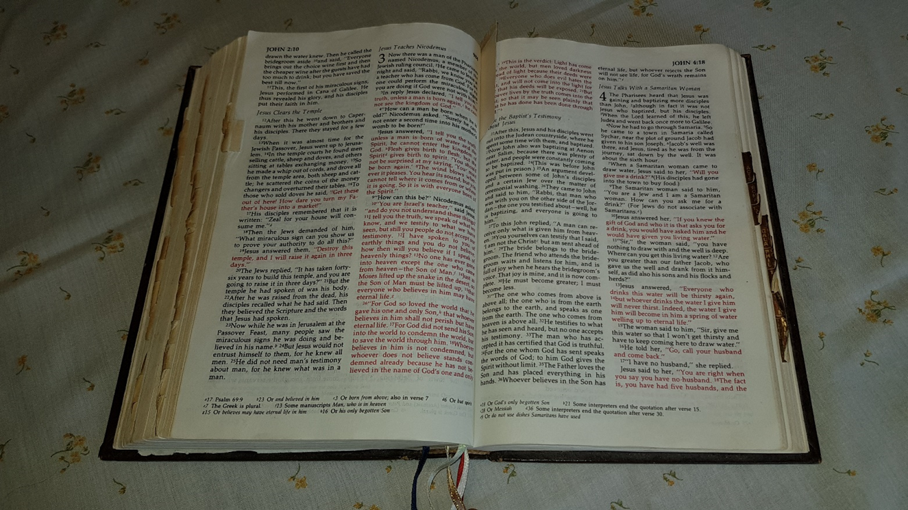

Slide 22
5) Means of Grace - Baptism and Holy Communion
Jesus instituted both Baptism and Holy Communion

Slide 23
5) Means of Grace - Baptism and Holy Communion
Jesus instituted both Baptism and Holy Communion
Baptism
Matt 28:19 “Therefore, go and make disciples of all the nations, baptising them in the name of the Father and the Son and the Holy Spirit.“

Slide 24
5) Means of Grace - Baptism and Holy Communion
Communion
Lk 22:19 “He took some bread and gave thanks to God for it. Then he broke it in pieces and gave it to the disciples, saying, “This is my body, which is given for you. Do this to remember me.
Matt 26:27 And he took a cup of wine and gave thanks to God for it. He gave it to them and said, “Each of you drink from it, [28] for this is my blood, which confirms the covenant between God and his people. It is poured out as a sacrifice to forgive the sins of many.”

Slide 25
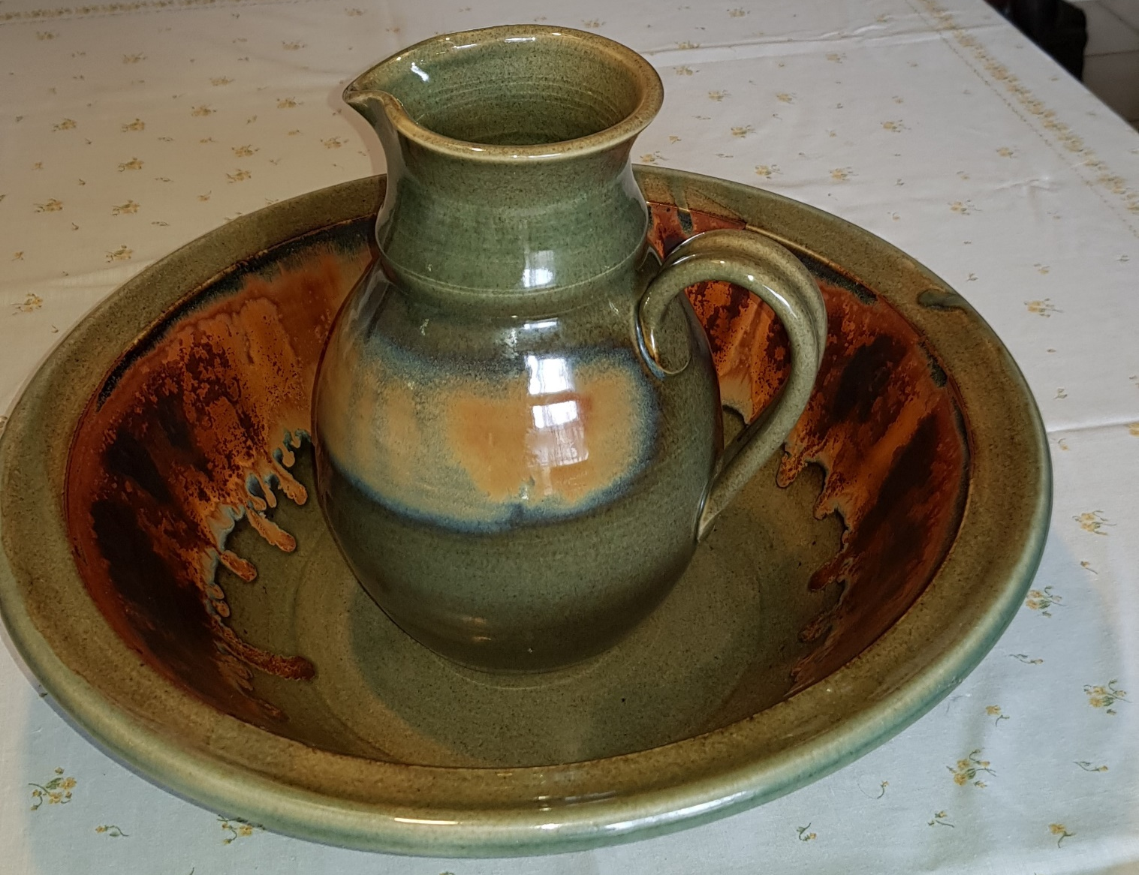
5) Means of Grace - Baptism and Holy Communion
A) Baptism
Baptism is an outward and visible sign of an inward and spiritual work of grace.

Slide 26
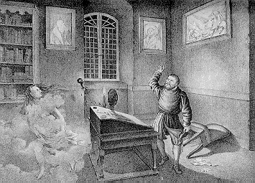
5) Means of Grace - Baptism and Holy Communion

Slide 27
5) Means of Grace - Baptism and Holy Communion
A) Baptism
Baptism is an outward and visible sign of an inward and spiritual work of grace.
Mk 1:8 John’s baptism, “I baptise you with water, but he will baptise you with the Holy Spirit!”.
Marks the beginning of Jesus’ public ministry
Jesus entrusted the ministry of baptism to the disciples.
Christian baptism marks our new identity in Christ.

Slide 28
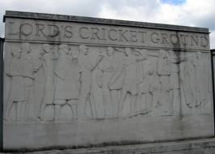
5) Means of Grace - Baptism and Holy Communion

Slide 29
5) Means of Grace - Baptism and Holy Communion
A) Baptism
Baptism is an outward and visible sign of an inward and spiritual work of grace.
Mk 1:8 John’s baptism, “I baptise you with water, but he will baptise you with the Holy Spirit!”.
Marks the beginning of Jesus’ public ministry
Jesus entrusted the ministry of baptism to the disciples.
Christian baptism marks our new identity in Christ.

Slide 30
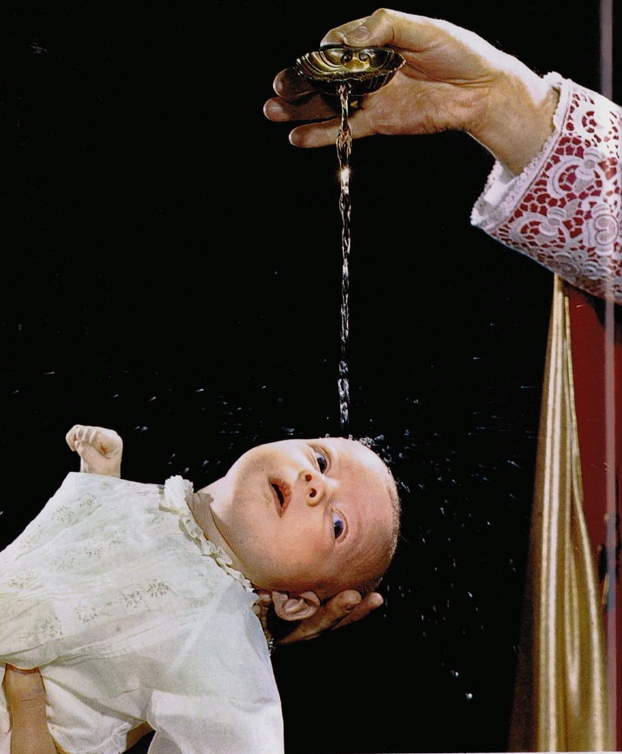
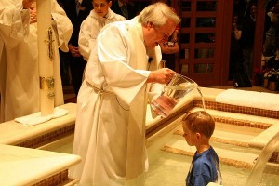
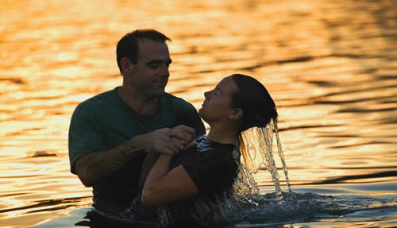
Exodus 29:7
Ezekiel 36:25
Romans 6:3 - 4

Slide 31
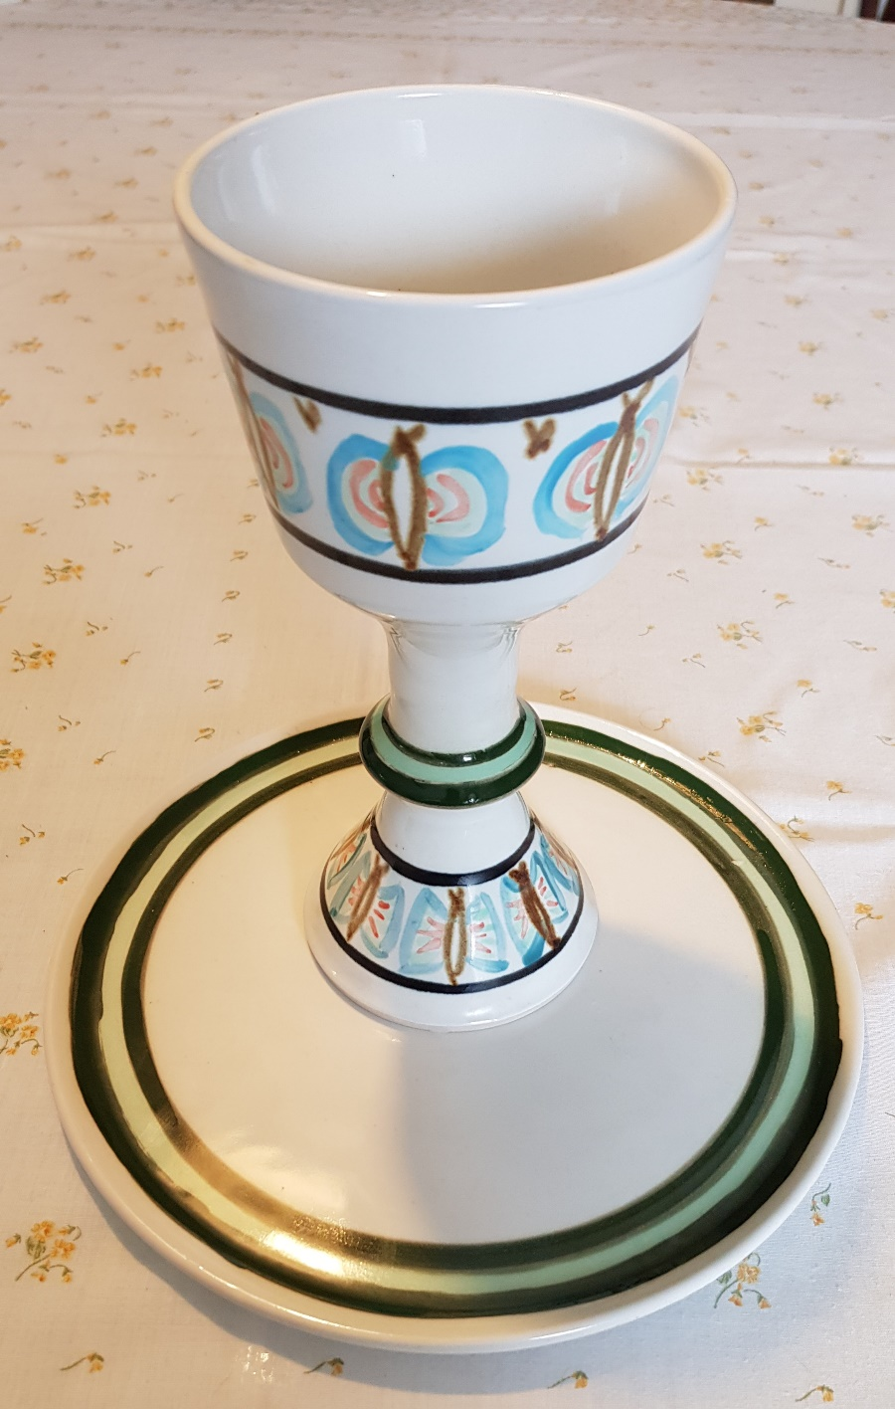
5) Means of Grace - Baptism and Holy Communion
B) Holy Communion
1 Cor 11:23-26 “... the Lord Jesus took some bread …and said, “This is my body, which is given for you. Do this to remember me.” In the same way, he took the cup of wine after supper, saying, “This cup is the new covenant between God and his people—an agreement confirmed with my blood. Do this to remember me as often as you drink it.”

Slide 32
5) Means of Grace - Baptism and Holy Communion
B) Holy Communion
We do it in remembrance of him.
On the first walk to Emmaus the two disciples had their eyes opened in the breaking of the bread.
We experience inward and spiritual grace.
We experience welcome and nourishment.
We experience the way God intends the world to be.

Slide 33
5) Means of Grace - Baptism and Holy Communion
C) Means of grace need room to grow
John 15:1 – 2 “I am the true grapevine, and my Father is the gardener. He cuts off every branch of mine that doesn’t produce fruit, and he prunes the branches that do bear fruit so they will produce even more.”
To make room for new life in Christ, something old has to die. God prunes away those dead and unproductive parts in our lives to enable us to be fruitful and productive disciples.
Consider this question:

Slide 34
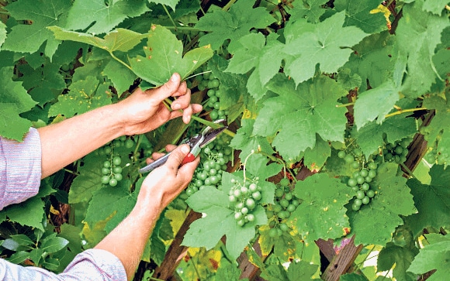
What has to be pruned or die in your life in order to keep experiencing God’s grace?

